Slide 1

Presentation on Library Management System
Presented by:
Sayantoni Dey
Dipanwita Mondal
Syed Abbas Ali
Rahul Dey
Saurabh Kumar Choudhary
Swapnali Chattopadhyay

Slide 2
Introduction
Library Management System is a comprehensive library management solution that is suitable for both large and small libraries.
This Library Management System Software is capable of handling books with equal ease and efficiency.
Its flexible design enables Library Management System to be installed easily.
The application is user friendly, robust and beneficial to the organization.

Slide 3
Objectives
Minimize wastage of time .
Reducing manual labour.
Security features like access control using passwords and login-id.
Efficient data access.
Keeping track of all actions taking place in the library.
Improved backup and recovery services.
Easy to handle.

Slide 4
Why you should buy this software?
Future aspects are high.
Costing of the software is reasonable.
It will make the work of management in the library much more easier and organized.

Slide 5
System Outline
HOME PAGE
ADD AND SAVE THE BOOK DETAILS
ADD MEMBER AND REMOVE MEMBER
LIBRARIAN CAN LOGOUT
SEARCH THE BOOK
ISSUE THE AVAILABLE BOOK AND SAVE THE ISSUED BOOK DETAILS
RETUNE THE ISSUED BOOK WITHIN DUE DATE OTHERWISE GIVE PENALTY

Slide 6






Features
Add Books
Search and Issue Books
Add Member
Remove Books
Return Books
Remove Member

Slide 7
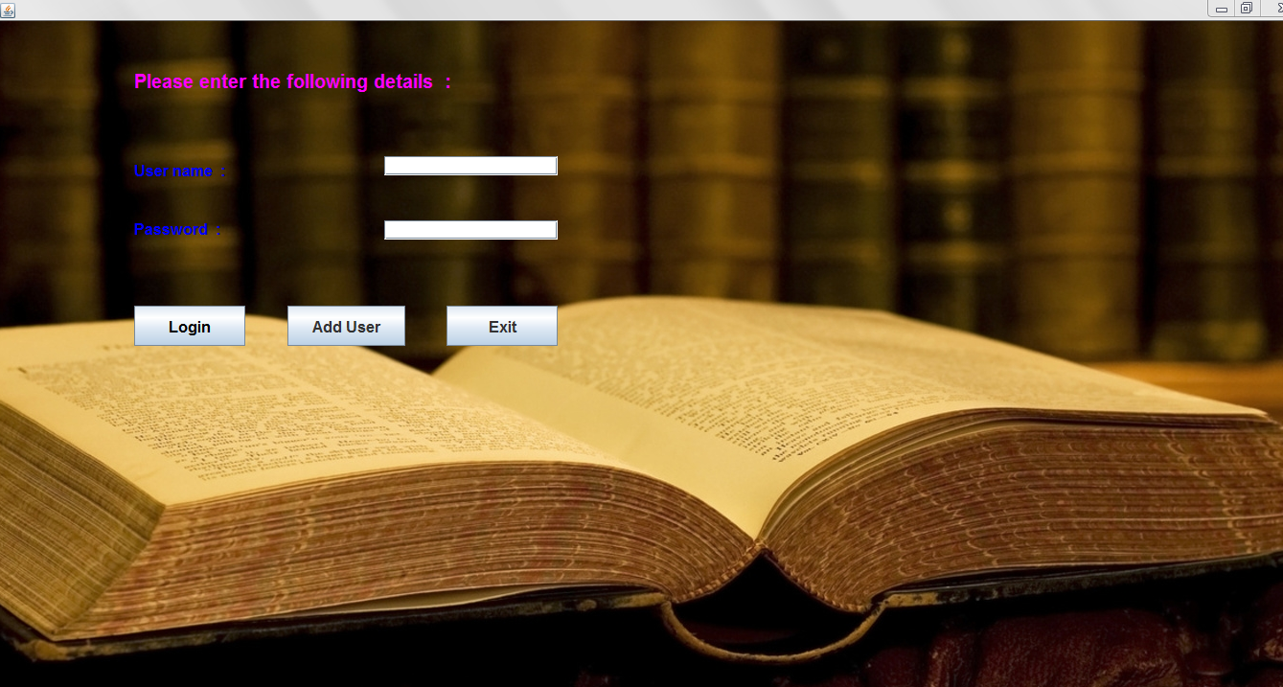
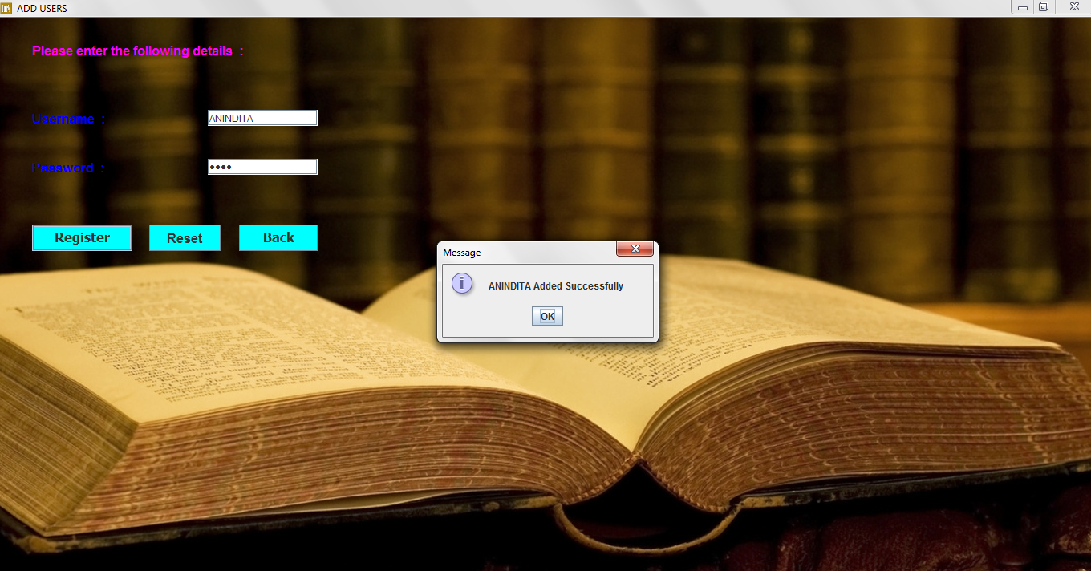
Login Page
Add User

Slide 8
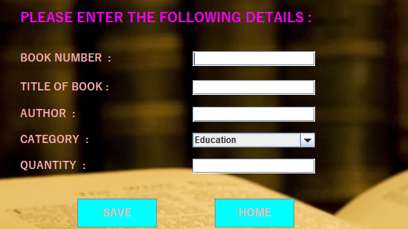
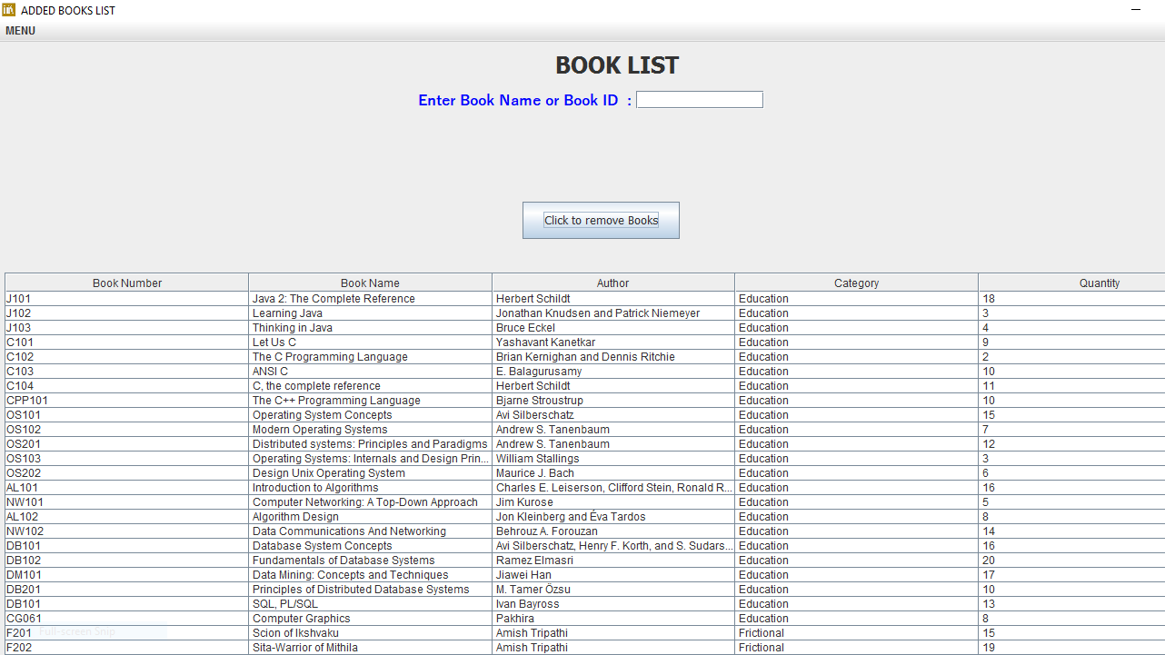
Add Books
Remove Books

Slide 9
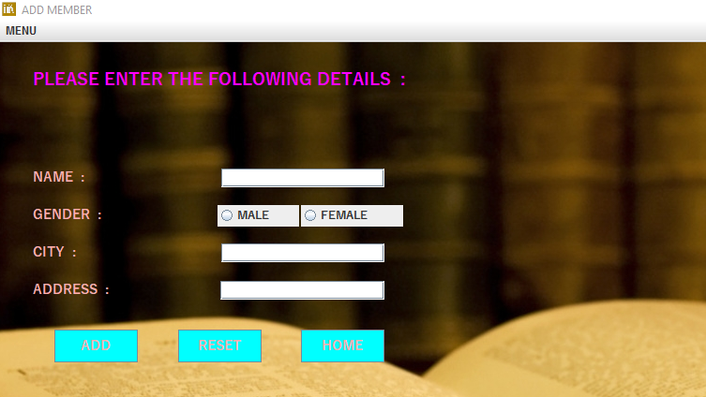
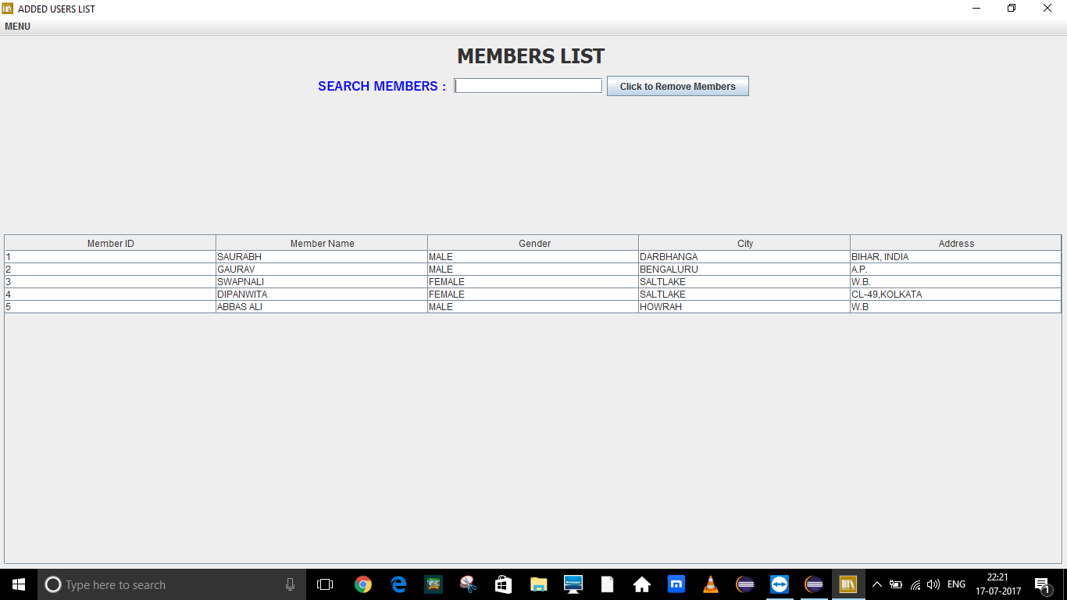
Add Member
Remove Member

Slide 10
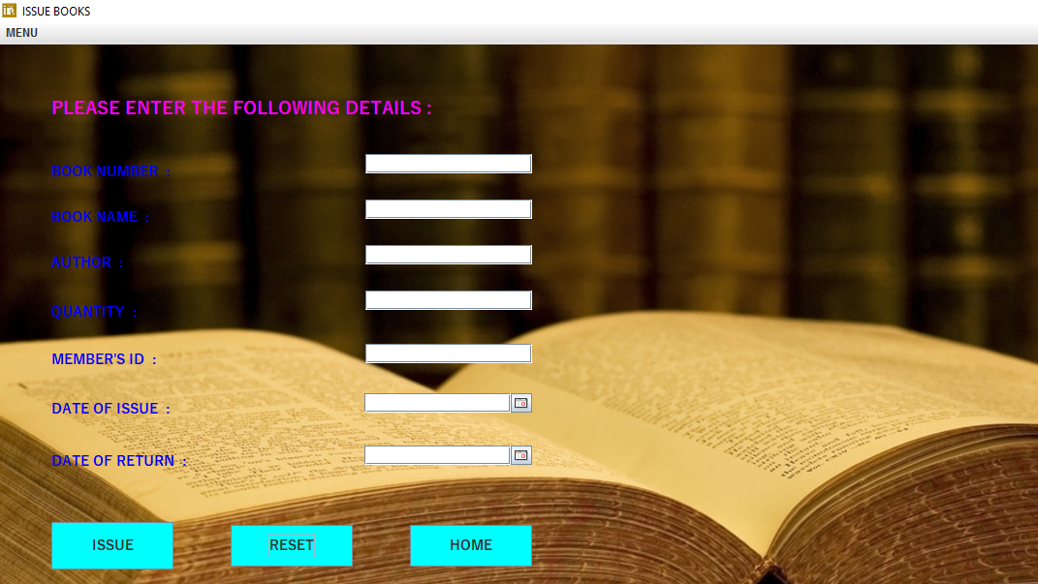
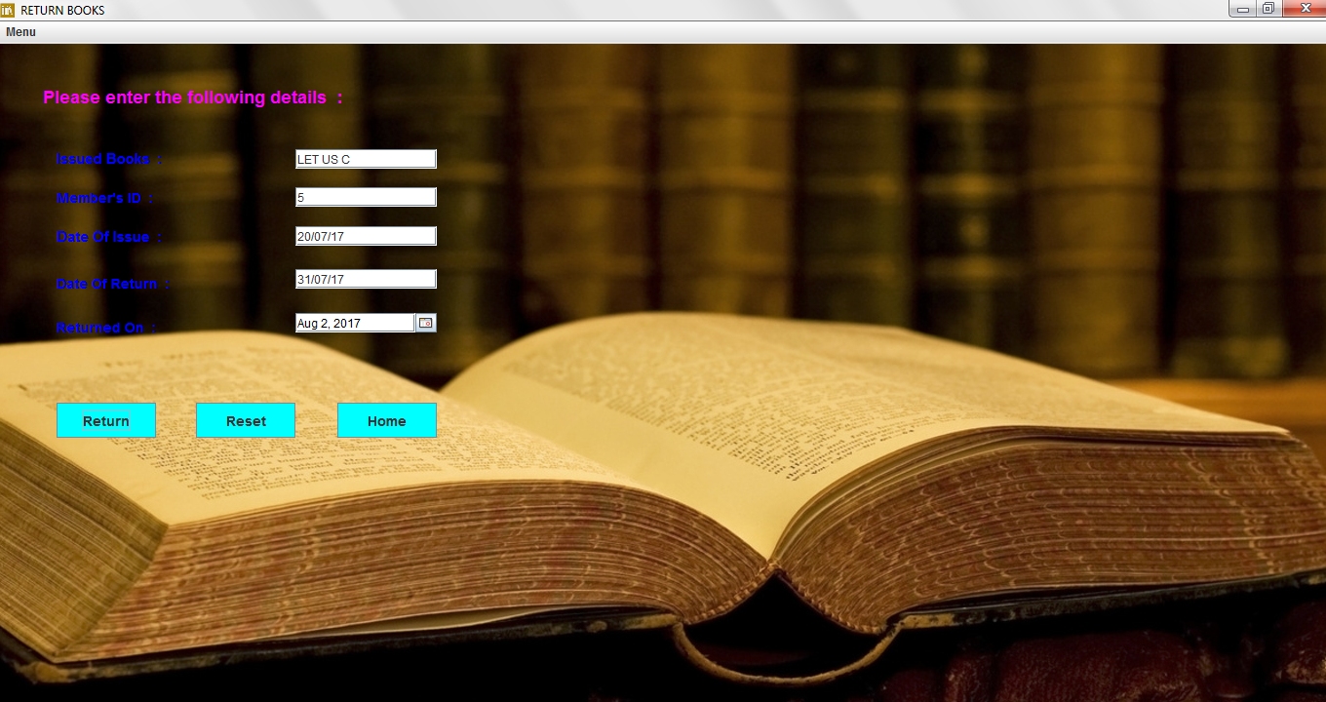
Search and Issue Books
Return Books

Slide 11
Resources Required
Hardware Requirement (minimum requirement):
Processor: AMD Sempron/intel Pentium 4
RAM: 2 GB
Hard Drive
Software Requirement (minimum requirement):
Operating System: Windows
Other Software: JDK, JRE, Eclipse.

Slide 12
Merits Of The Software
Purpose of the system is an automated “LIBRARY MANAGEMENT SYSTEM”. Through our software, user can add members, add books, search books, update information, edit information, borrow and return books. Our system has the following advantages:-
User friendly interface
Fast access to database
Less error
Search facility
More Storage Capacity
Quick transaction
All the manual difficulties in managing the Library have been rectified by implementing computerization.

Slide 13
Demerits Of The Software:-
Cannot support huge data.
It is not a full-proof solution for library management.
Limited to the knowledge of user/developer.

Slide 14
Future Scope of Improvement
As the technology emerges, it is possible to upgrade the system and can be adaptable to desired environment.
This software can be used to form an online library management system.
Member module can be introduced.
Admin module can be introduced.
Forget Password : Upon forgetting password, user can change the same by following few easy steps.

Slide 15
Conclusion
From a proper analysis of the positive points and constraints on the component, it can be safely concluded that the product is a highly efficient GUI based component .This application is working properly and meeting to all user requirements. This component can be easily plugged in many other systems.

Slide 16
Acknowledgement
We extend our heartfelt thanks and gratitude to our mentor Mr. Dayamay Halder, for his guidance and continuous encouragement. This presentation would not have been possible without his valuable inputs and supervision. His frequent blessings, help and cooperation shall carry us a long way in the journey of life on which we are about to embark. Also a heartiest thanks to Team Globsyn for organizing the entire training procedure.

Slide 17
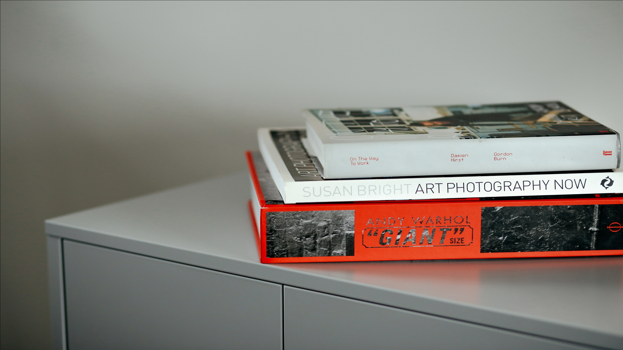
ANY QUIRES?
ANY QUIRIES?
THANK YOU
THANK YOU

